Slide 1
Kleene’s Theorem
If a language can be expressed by
FA or
TG or
RE
then it can also be expressed by other two as well.
It may be noted that the theorem is proved, proving the following three parts

Slide 2
Kleene’s Theorem continued …
Kleene’s Theorem Part I
If a language can be accepted by an FA then it can be accepted by a TG as well.
Kleene’s Theorem Part II
If a language can be accepted by a TG then it can be expressed by an RE as well.
Kleene’s Theorem Part III
If a language can be expressed by a RE then it can be accepted by an FA as well

Slide 3
Kleene’s Theorem continued …
Proof(Kleene’s Theorem Part I)
Since every FA can be considered to be a TG as well, therefore there is nothing to prove.

Slide 4
Kleene’s Theorem continued …
Proof(Kleene’s Theorem Part II)
To prove part II of the theorem, an algorithm consisting of different steps, is explained showing how a RE can be obtained corresponding to the given TG. For this purpose the notion of TG is changed to that of GTG i.e. the labels of transitions are corresponding REs.

Slide 5
Kleene’s Theorem part II cont …
Objective of Algorithm:
Basically this algorithm converts the given TG to GTG with one initial state along with a single loop, or one initial state connected with one final state by a single transition edge. The label of the loop or the transition edge will be the required RE.

Slide 6
Kleene’s Theorem part II cont …
Step 1
If a TG has more than one start states, then introduce a new start state connecting the new state to the old start states by the transitions labeled by Λ and make the old start states the non-start states. This step can be shown by the following example

Slide 7
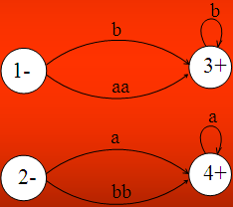

Example

Slide 8
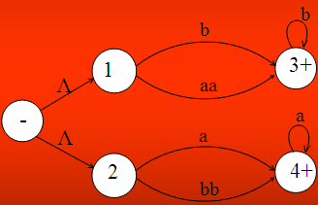
Example Continued ...

Slide 9
Kleene’s Theorem part II
Step 2:
If a TG has more than one final states, then introduce a new final state, connecting the old final states to the new final state by the transitions labeled by Λ.
This step can be shown by the previous example of TG, where the step 1 has already been processed

Slide 10
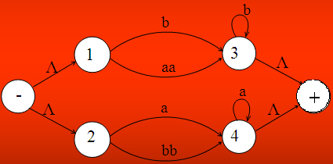
Example continued …

Slide 11
Kleene’s Theorem part II
Step 3:
If a state has two (more than one) incoming transition edges labeled by the corresponding REs, from the same state (including the possibility of loops at a state), then replace all these transition edges with a single transition edge labeled by the sum of corresponding REs. This step can be shown by a part of TG in the following example

Slide 12
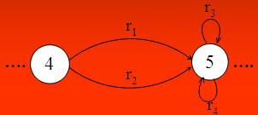
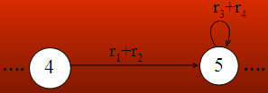
Example
The above TG can be reduced to

Slide 13
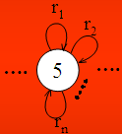

Note
The step 3 can be generalized to any finite number of transitions as shown below
The above TG can be reduced to

Slide 14
Kleene’s Theorem part II
Step 4 (bypass and state elimination)
If three states in a TG, are connected in sequence then eliminate the middle state and connect the first state with the third by a single transition (include the possibility of circuit as well) labeled by the RE which is the concatenation of corresponding two REs in the existing sequence. This step can be shown by a part of TG in the following example

Slide 15
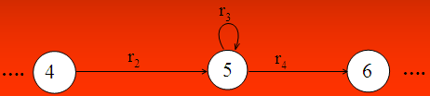

Example
To eliminate state 5 the above can be reduced to
Consider the following example containing a circuit

Slide 16

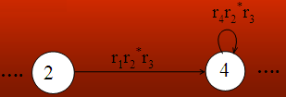
Example
Consider the part of a TG, containing a circuit at a state, as shown below
To eliminate state 3 the above TG can be reduced to

Slide 17

Example
Consider a part of the following TG
To eliminate state 3 the above TG can be reduced to

Slide 18


Example continued ...
To eliminate state 4, above TG can be reduced to

Slide 19
Note
It is to be noted that to determine the RE corresponding to a certain TG, General four steps have been discussed.
This process can be explained by the following particular examples of TGs.

Slide 20
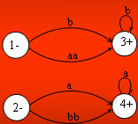
Example
Consider the following TG
To have single initial and single final state the above TG can be reduced to the following

Slide 21
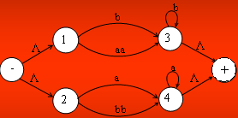
Example continued …
To obtain single transition edge between 1 and 3; 2 and 4, the above can be reduced to the following

Slide 22
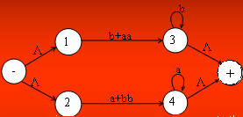

Example continued …
To eliminate states 1,2,3 and 4, the above TG can be reduced to the following TG

Slide 23


Example continued …
To connect the initial state with the final state by single transition edge, the above TG can be reduced to the following
Hence the required RE is (b+aa)b*+(a+bb)a*

Slide 24

Example
Consider the following TG, accepting EVEN-EVEN language

Slide 25
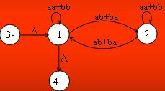
Example continued ...
To eliminate state 2, the above TG may be reduced to the following

Slide 26
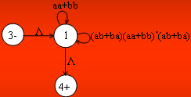
Example continued ...
To have single loop at state 1, the above TG may be reduced to the following

Slide 27
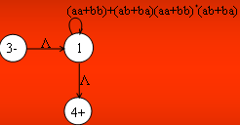
Example continued ...
To eliminate state 1, the above TG may be reduced to the following

Slide 28

Example continued ...
Hence the required RE is
( aa + bb + (ab+ba)(aa+bb)*(ab+ba) )*

